Slide 1

Logging in a DevOps World
– Fred –
A PSFramework
Presentation
https://psframework.org

Slide 2
Notes:
However ... it saddens me to have to bring terrible news:
I bring news … of a murder

Slide 3

Notes:
Poor Bello was found dead on the street.
Roasted as if struck by lightning, though it had been a cloudless day (No, was not in Seattle)

Slide 4

Notes:
In fact, Bello was not the only such victim!

Slide 5


Notes:
Again and again, innocent, cuddly and fluffy creatures are being murdered!
You HAVE to help me, to put an ... (END)

Slide 6




Notes:
... end to this ... (ACT)

Slide 7



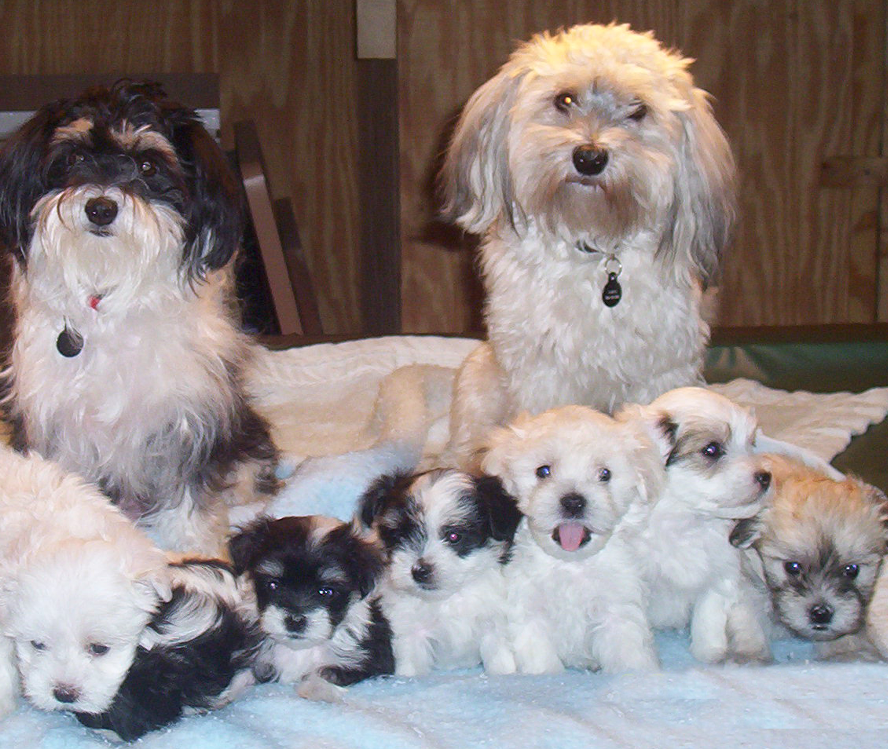


Notes:
... ACT of ... (MASS)

Slide 8





Notes:
... MASS PUPPYCIDE!

Slide 9
Stop using Write-Log!
or Write-Host
or Write-Verbose
or Write-Warning
or Write-Debug
or Write-Information

Slide 10
Write-PSFMessage
Use …
… instead

Slide 11
Agenda
Logging in Action
Going DevOps
The Architecture
Multilingual – Logging and Localization
Extending the logging

Slide 12
Logging in Action
<DEMO>

Slide 13
Going DevOps
Going DevOps

Slide 14
Requirements
Manageable
Scalable
Low Impact
Adaptable
Migratable

Slide 15
Manageable & Adaptable
Controlled by Configuration
Deployable through:
GPO
SCCM
DSC
Puppet
Ansible
…

Slide 16
Scalable & Low Impact
Data Provider, not Data Manager
Runspace-Safe / Thread-Safe
Asynchronous

Slide 17
Migratable
Extensible with PlugIns (Logging Providers)
Provider Coexistence
→ Enables testing new system in production without impact.

Slide 18
The Architecture

Slide 19

The basic Layout*
Write-PSFMessage
Message
?
?
?
Logs
*Some details might (still) be obscured

Slide 20
Stop with those slides, dammit!!
<DEMO>

Slide 21
The Truth and only the Truth*
Runspace 1
Runspace: psframework.logging
Runspace 2
Write-PSFMessage
Write-PSFMessage
Provider 1
Filter
Message
Message
(Enabled)
Runspace 3
Queue
Dispatcher
Provider 2
Write-PSFMessage
Filter
Message
(Enabled)
Runspace 4
Provider 3
Write-PSFMessage
Filter
Message
(Disabled)
*Still not all there is to it

Slide 22
For the nitpickers
Queue
Write-PSFMessage
Message
Transformers
Exception
Transformers
Message
Policies
Level
Modifiers
Message
Events
Message

Slide 23
Multilingual
Logging and Localization

Slide 24
Gods of PowerPoint, have mercy! Spare us!
<DEMO>

Slide 25
Extending the Logging
Creating Custom Logging Providers

Slide 26
Logging Providers
Defines custom logging processing
Offers 'events' that providers can 'subscribe' to
One resource scope, variables persist
Potential for conflict between providers
Prefix every variable and function with the provider name!

Slide 27
Workflow
Begin
Finally
Start
Message
Error
End

Slide 28
I thought this was about PowerShell …
<DEMO>

Slide 29
Modules:
dbatools
PSFramework
PSModuleDevelopment
PSUtil
MailDaemon
Krbtgt
JEAnalyzer
…
Twitter: @FredWeinmann
PS Slack: Fred
Summit Slack: Fred
https://psframework.org
https://github.com/FriedrichWeinmann
No Puppies were harmed in the production of this presentation

